Slide 1


Real-time Neural Network Inference on Extremely Weak Devices: Agile Offloading with Explainable AI
Kai Huang and Wei Gao
University of Pittsburgh
MobiCom 2022
Notes:
Hi everyone. I am Kai Huang from University of Pittsburgh. It’s my pleasure to present our work, “Real-time Neural Network Inference on Extremely Weak Devices: Agile Offloading with Explainable AI”. This is a joint work with my advisor Dr. Wei Gao at University of Pittsburgh.

Slide 2

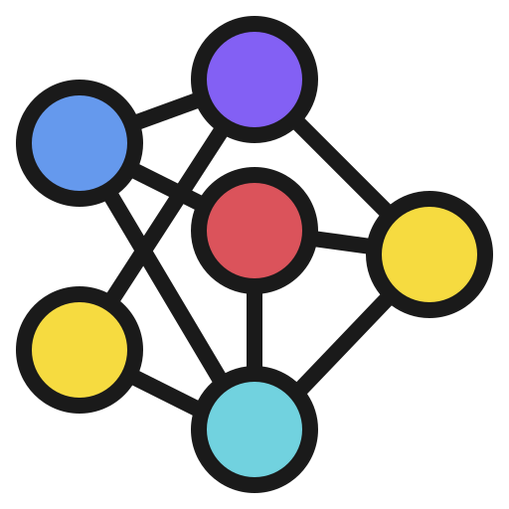


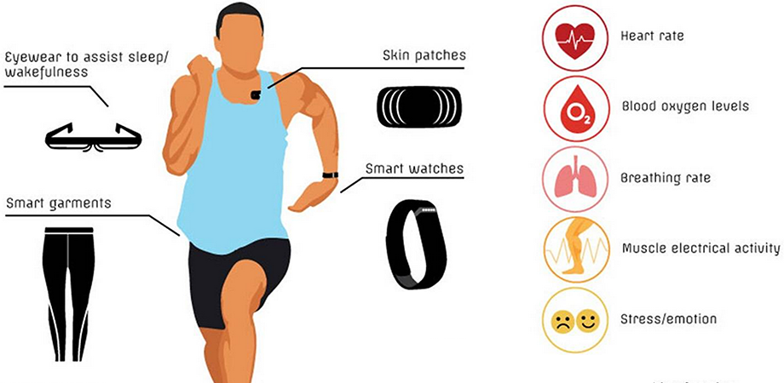


Bring Real-time AI to Weak Embedded Devices
Prediction & Decision making
Wearables for Health Monitoring
Small Robots for Autonomous Navigation
Sensors & Actuators for Smart Home
Notes:
[WG] In all your oral speaking, please speak “neural networks” instead of “NNs”
With the increasing capability of neural networks, there is a pressing need of enabling real-time NN inference on weak embedded devices, to allow more intelligent decision making. For example:
[x] Neural networks could be running on wearables to detect health risks
[x] They could also assist small drones and robots to better perceive and interact with the surroundings for autonomous navigation
[x] In smart home scenarios, NNs could be deployed on sensors and actuators to optimize living conditions, such as access control, HVAC and lighting control

Slide 3
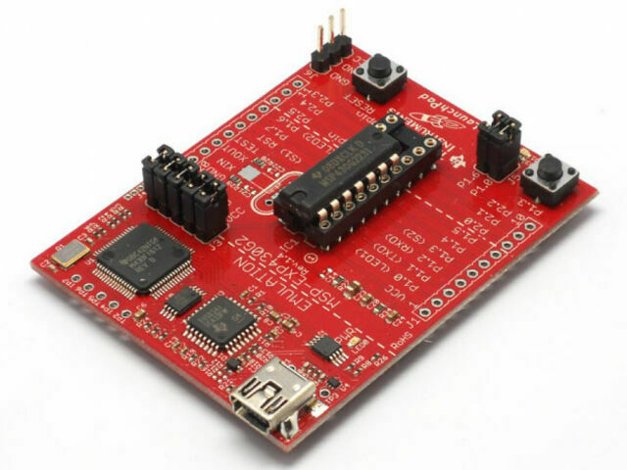
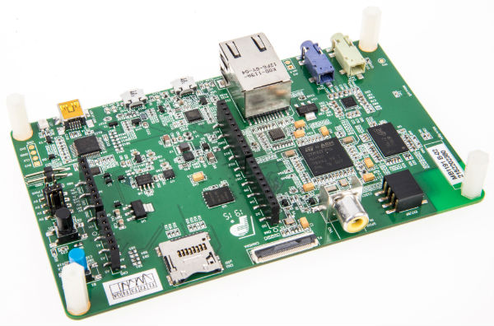
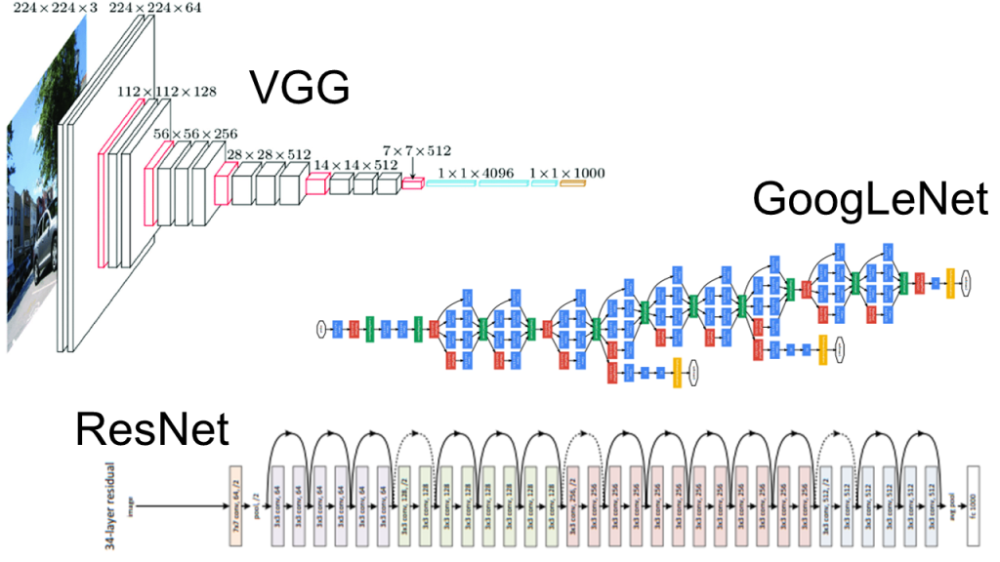
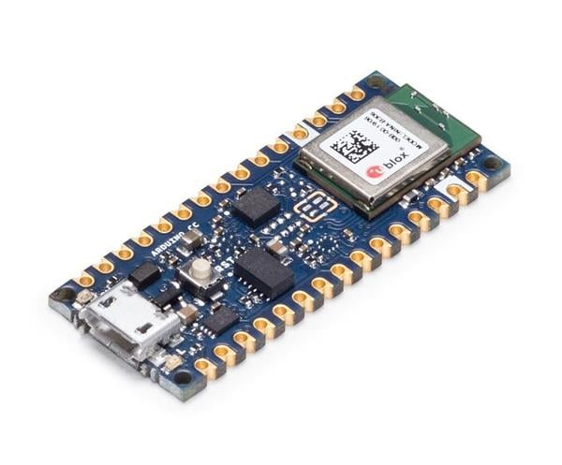

Resource Limits on Weak Embedded Devices
Weak Embedded Devices
Large Neural Networks
< 1 MB memory and storage
Requires > 100 MB of memory space
16 ~ 216 MHz CPU
> 2 GHz CPU for 60 ms latency
Notes:
However, deploying neural networks on these small devices is very challenging because of the huge gap between these devices’ weak capabilities and neural networks’ high computing demands. For example:
Commonly used microcontrollers such as STM32 and MSP430 only have less than 1MB memory and tens to hundreds of MHz CPUs.
[x] But popular convolutional networks like ResNet50 and VGG16 require over 100MB of memory, and 2GHz CPU to achieve 60ms inference latency. Such requirement may be achieved on powerful mobile devices such as smartphones and laptops.
[x] But it is unaffordable for weak microcontrollers.

Slide 4
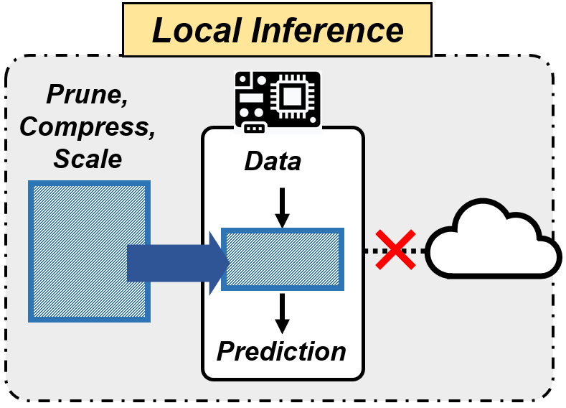
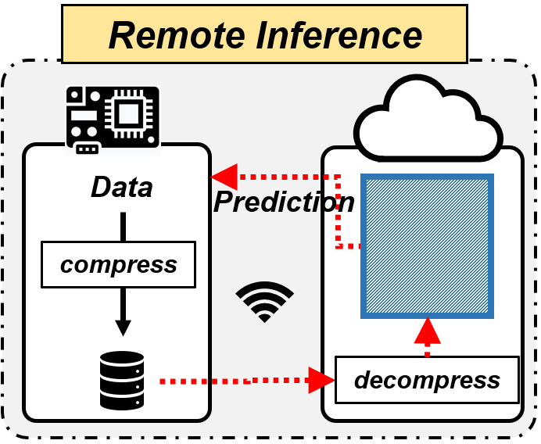
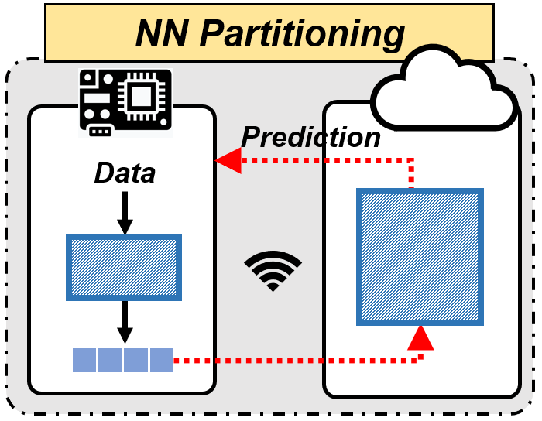
Existing Solutions
Local Inference
Pruning, compression, NAS
Leads to oversimplified NN structures
> 10% accuracy loss
Remote Inference
Compress raw data before transmission
Limited data compressibility when the accuracy loss is minimum
NN Partitioning
Use a local NN to sparsify & compress data
Higher compressibility but expensive local NNs
Notes:
[WG] I removed the annotation table here. Make sure that you explain the annotations of NN and features. The rest are easy to understand.
[x] To bridge this gap, researchers have used pruning, compression and neural architecture search to reduce the local neural network complexity. However, to fit to the embedded devices’ local resource constraints, these techniques always lead to oversimplified neural network structures and reduce the inference accuracy.
[x] Instead, a better solution to avoiding accuracy loss is to offload the NN computation to a remote server. To minimize the communication cost, one can compress the NN input data before transmission, but the compression ratio cannot be too high to avoid information loss, and aggressively compressing data will lose important information in data and reduces accuracy.
[x] Later research efforts suggest partitioning the NN and using a local NN to sparsify the data into a more compressible feature space before transmission. However, they need to use an expensive local NN to correctly extract data features and enforce feature sparsity. Such expensive local NN, in most cases, are unaffordable by weak embedded devices.

Slide 5
Existing Solutions
Best of existing approaches
Minimal on-device cost
Our approach
… …
Data sample
Data-centric:
Consider data samples’ heterogeneity
– feature importance
Fixed learning schemes
Agile offloading:
Adaptive partitioning to minimize the offloading cost
Cumbered by the worst case
Notes:
[x] The key reason for this expensive local NN is that the existing NN partitioning schemes regardlessly apply the same learning scheme to every input data sample. In other words, even for easier data samples, they will still need to spend the same computing cost as for the most difficult data sample.
[x] Instead, our goal is to shift the rationale of NN partitioning and offloading from fixed to agile and data-centric. Specifically, we identify different data samples’ heterogeneity in NN inference as the importance of different data features to NN inference, and incorporate such feature importance into the offloading strategy. In this way, the weak device can adaptively partition the NN inference for each data sample according to its characteristics, to minimize the offloading cost.

Slide 6


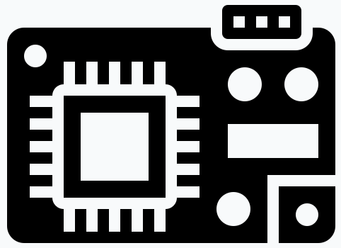


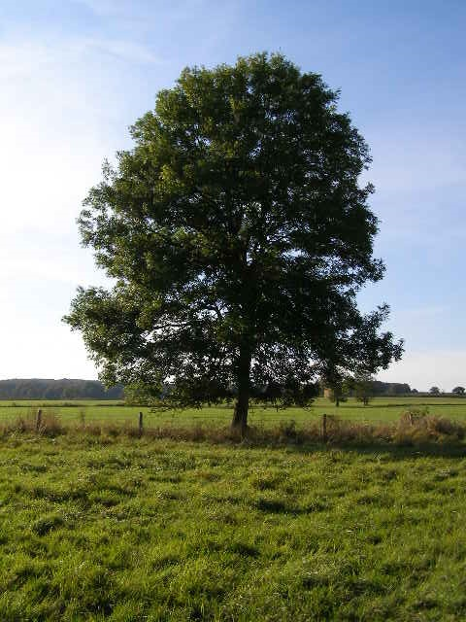

AgileNN: From Fixed to Data-centric & Agile
Data sample
Importance of its features
For every input data sample,
Important features: clearer to perceive → handled locally
Less important features: more compressible → offload
Data
Feature Extractor
Remote NN
Local NN
… …
… …
Challenge 1: How to correctly evaluate feature importance?
Challenge 2: How to maximize the compressibility of less important features?
Prediction
Notes:
Based on this basic idea, we propose AgileNN, a new offloading technique [x] that adapts the offloading strategy to each data sample.
[x] [x] On the local device, a lightweight feature extractor will be used to evaluate the importance of each data sample’s extracted features to the inference task, and these features are partitioned into important and less important features.
[x] Only the few important features will be retained locally and their representativeness allows them to be perceived by a lightweight local NN.
[x] The less important features are less relevant to the inference task and are hence more compressible. They will then be compressed with much higher ratio and offloaded for remote inference with much lower cost.
[x] Finally, predictions from Local and remote will be combined on the local device.
[x] To realize this offloading framework, we will have to address two challenges. The first is how to correctly and efficiently evaluate feature importance, and the second is how to maximize the compressibility of less important features to be transmitted.

Slide 7


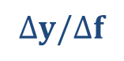
Solving Challenge 1: Evaluating Feature Importance via Explainable AI
An Explainable AI (XAI) workflow
$$Δy/Δf$$
Gradients
feature importance
Feature Extractor
Predictor
Dog: 0.99
$$y$$
Cat: 0.01
$$f$$
But XAI tools are computationally expensive!
Instead, we offline train an XAI-enabled feature extractor
Always produce top important features at first-k channels
offline train
Explainable AI Tool
Feature Extractor
Data
Notes:
Our solution to the first challenge is to leverage Explainable AI to evaluate feature importance.
[x] Typical XAI techniques compute the neural network output’s gradients with respect to feature variables.
[x] By analyzing these gradients, XAI reports the importance score indicating each feature’s contribution to the neural network’s prediction.
[x] However, running XAI tools at run-time is computationally expensive because gradient calculation require hundreds of MB of memory and the XAI algorithm itself may need many iterations to produce a single result, which is not affordable on small embedded devices.
[x] Instead, we migrate the such online computation to offline by training an XAI-enabled feature extractor
[x] During offline training, XAI is acting as a supervisor that trains the feature extractor to output features that always produces top important features at first-k channels.
[x] Then, during online inference, the produced feature vector can be directly used to split data features into important and less important portions.

Slide 8
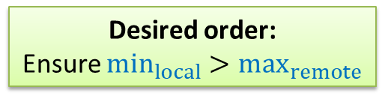
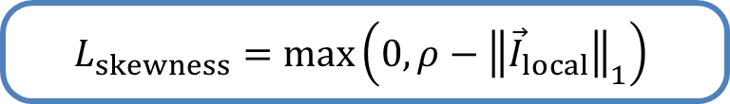
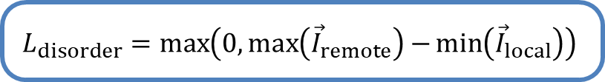
Solving Challenge 2: Enforcing Skewed Distribution of Feature Importance via XAI Loss Function
Disorder Loss:
Ensure topmost important features are extracted into the first-k channels
→ Avoid online importance evaluation
Skewness Loss:
Enhance the importance of top-k features to ensure compressibility of the others
To local NN
To remote NN
To local NN
To remote NN
0.4
Random order
Not enough compressibility
Importance
0.3
Importance
0.2
0.05
0.05
Feature index
Feature index
$$L_{disorder}=\max\left(0,\max\left({\vec{I}}_{remote}\right)−\min\left({\vec{I}}_{local}\right)\right)$$
$$L_{skewness}=\max\left(0,ρ−{\left\|{\vec{I}}_{local}\right\|}_{1}\right)$$
Desired order:
Ensure $\min_{local}>\max_{remote}$
min
0.4
Importance
0.3
Importance
Higher compressibility
0.2
max
0.05
0.05
Feature index
Feature index
Notes:
Our solution to the second challenge is to make sure that the distribution of feature importance is highly skewed, such that the importances of few top features are much higher than the importance of the rest majority of features. Such skewness ensures that the less important features are highly redundant and can be compressed at high ratio.
[x] We enforce such skewness when training the feature extractor, by controlling the loss function. More specifically, our design of the loss function consists of two parts: the disorder loss and skewness loss.
[x] We first use the disorder loss to ensure that the topmost important features are always extracted into the first-k channels in the feature vector.
[x] In particular, the disorder loss encourages the lowest importance of the first-k features to be larger than the highest importance of the remaining features. Achieving this only requires minimal ordering efforts, so it can be learned by a lightweight feature extractor.
[x] We express the loss function using min max functions, which are differentiable to compute training feedbacks.
[x] After that, we further use the skewness loss to enforce skewness, between the group of important features in the first-k feature channels and the group of less important features in other feature channels.
[x] we also use max function to express the skewness loss. The user can set a specific objective, indicated as \rho, for the cumulative importance of the top-k features that will be retained at the local device.

Slide 9
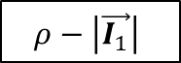
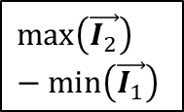
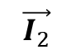
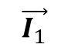
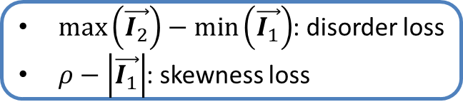
AgileNN’s Offline Training Framework
AgileNN
Local NN
Input data
first-k
remainder
Feature Extractor
Remote NN
Prediction
Use an off-the-shelf pretrained NN for accurate importance evaluation
$\max\left(\vec{I_{2}}\right)−\min\left(\vec{I_{1}}\right)$: disorder loss
$ρ−\left|\vec{I_{1}}\right|$: skewness loss
Training feedback
$$\vec{I_{1}}$$
$$\max\left(\vec{I_{2}}\right)−\min\left(\vec{I_{1}}\right)$$
Reference NN
Explainable AI Tool
Pred.
d
Label
$$\vec{I_{2}}$$
$$ρ−\left|\vec{I_{1}}\right|$$
Feature Importance Evaluator
XAI Loss
Pred. Loss
Notes:
Based on such loss functions, we present the offline training procedure of AgileNN, which jointly trains the feature extractor, local NN and remote NN. The feature extractor extracts features from every training data sample. The first k feature channels are used as the input to the local NN and the remaining channels are the input to the remote NN.
[x] During training, the feature vector of each training data sample is sent to an XAI-based feature importance evaluator. We use an off-the-shelf pretrained NN as a reference NN to ensure accurate importance evaluation. Otherwise, during training when the local and remote NN are not well-trained, the gradients computed by XAI tools are random and the importance scores cannot provide correct guidance.
[x] The evaluated importance scores will be used to construct the XAI loss function as described before, which firstly ensures the features at the first k channels are topmost important, and secondly ensures the importance skewness to improve the compressibility of the remaining features.
[x] Of course, the training is also supervised by the regular prediction loss function to ensure inference accuracy.

Slide 10
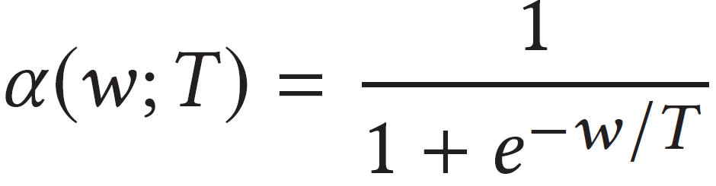
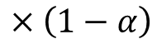
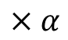
Combining Predictions & Preprocessing
Combining local & remote predictions
Local NN
Ensures predictions to be in the same scale
$$×α$$
Final Prediction
Remote NN
$$×\left(1−α\right)$$
Preprocessing the feature extractor
Index mapping
→ local
Feature Extractor
Rearrange the indices to reduce unsorted cases in training data
→ remote
Notes:
[x] The local and remote NNs are trained to combine the predictions together for a final prediction. The main issue is that the two predictions have different scales, so if we simply sum their prediction probabilities together, some small but important prediction values can be overwhelmed by other large but less important values. To address this issue, we introduce alpha that is parametrized by a learnable weight w to combine two predictions as a weighted sum. The temperature T controls the sharpness of alpha. More details of the hyperparameter tuning can be found in our paper.
[x] Besides these training modules, we also preprocess the feature extractor to make the training process more stable. Specifically, we rearrange the indices of the feature extractor’s output, so that most of the features will be already sorted before training. This is done by counting the frequency of the top important feature appearances in each feature channel. Please refer to our paper for detailed algorithms.

Slide 11
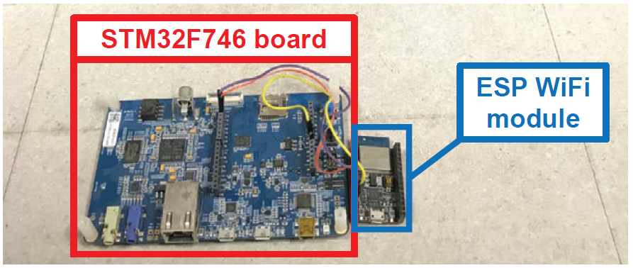
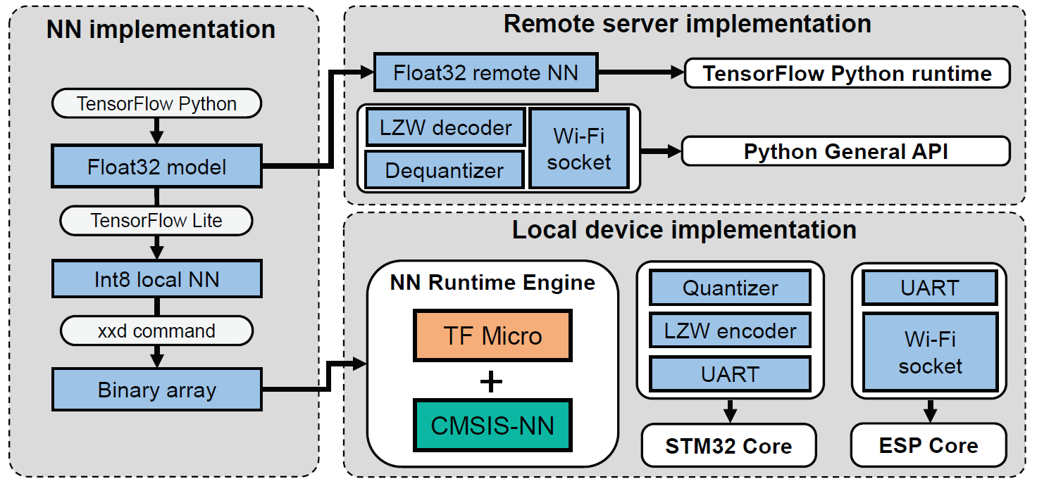
Implementation & Evaluation Setup
Local device
STM32F746 board, 216MHz, 320kB SRAM, 1MB FRAM
ESP-WROOM-02D WiFi module @ 6Mbps
Remote device
Dell-Precision 7820 workstation
A 3.6 GHz 8-core Xeon CPU and a 48GB Nvidia RTX A6000 GPU
Baselines
MCUNet [1] – NAS to find the best local NN
Edge-only – compress and offload raw data
DeepCOD [2] – use a NN-based encoder
SPINN [3] – early-exit inference
Datasets
CIFAR-10/100, SVHN, Tiny ImageNet (200 classes)
[1] J Lin, et al. MCUNet: Tiny deep learning on IoT devices. NIPS 2020.
[2] S Yao, et al. Deep compressive offloading: Speeding up neural network inference by trading edge computation for network latency. SenSys 2020.
[3] S Laskaridis, et al. SPINN: synergistic progressive inference of neural networks over device and cloud. MobiCom 2020.
Notes:
We implemented our offline training procedure using tensorflow and deployed the trained local NN and remote NN on a weak microcontroller board and a Dell workstation, respectively. The microcontroller board is equipped with an ESP WiFi module for wireless data transmission.
In our evaluation, we choose three types of baselines:
MCUNet is the local inference method, it uses NAS to find the best local NN within the given NN complexity constraint.
Edge-only inference is to offload all the raw input data to the edge server.
DeepCOD and SPINN are two different NN partitioning approaches that use a local NN to encode the raw data before compression and offloading.
We focus on image recognition tasks and use CIFAR, SVHN and a subset of ImageNet as the datasets in evaluation.

Slide 12
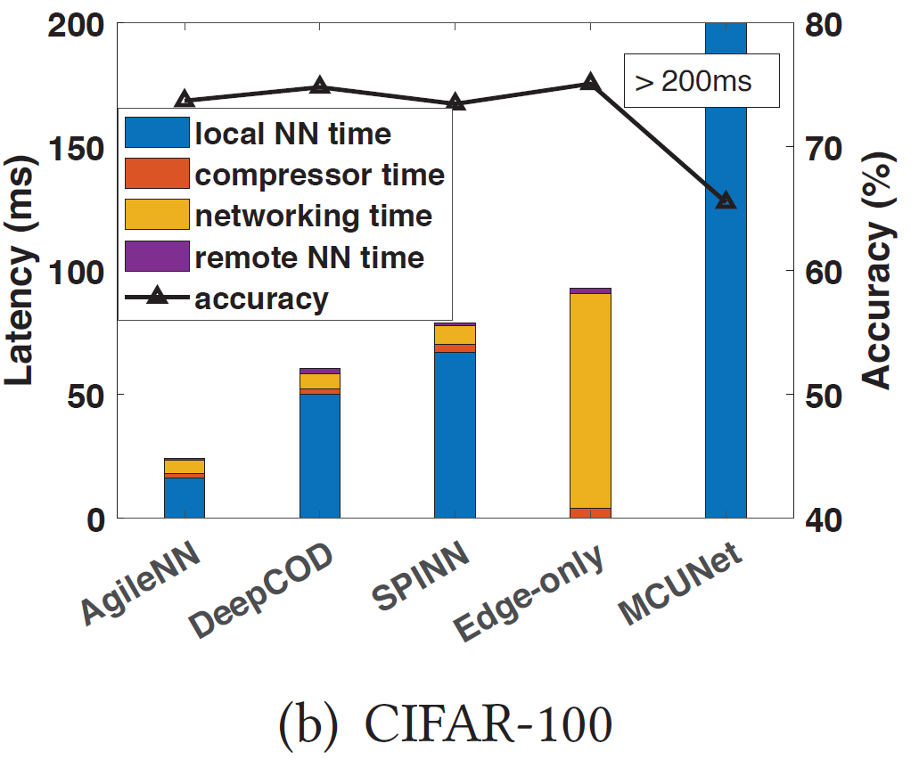
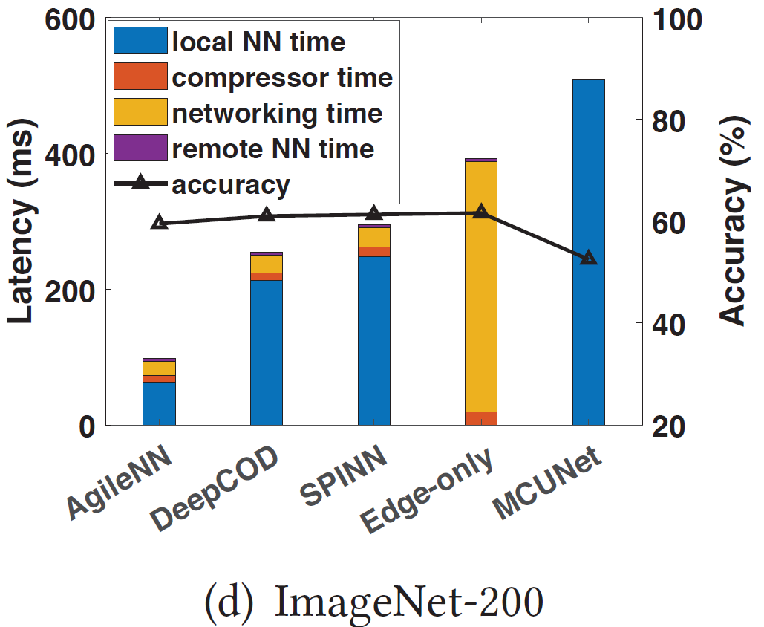
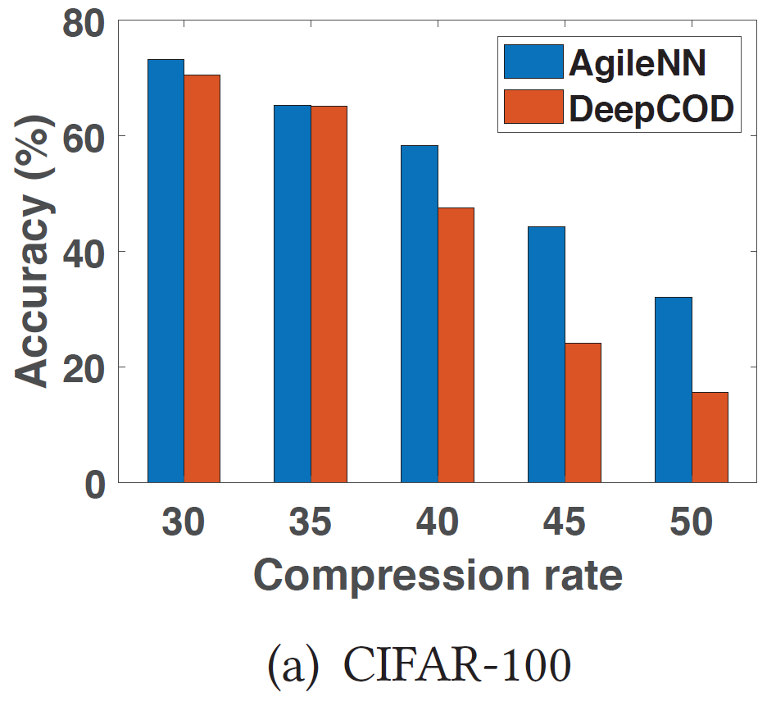
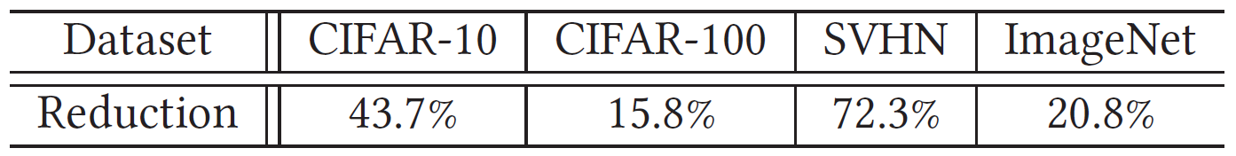
Evaluation: Overall Performance
AgileNN reduces end-to-end latency by 2x-2.5x
Reduction of transmitted data size compared to DeepCOD
Notes:
For easier comparisons, we configure the NN complexities of existing approaches so that the difference between their’s and AgileNN’s inference accuracy is always within 10%. The results show that AgileNN is able to reduce the end-to-end inference latency by 2x-2.5x, while keeping similar inference accuracy with DeepCOD and SPINN. We further break down the end-to-end latency results in detail, and we find that the AgileNN’s latency reduction mainly comes from the lower local NN computing time, which can be up to 10x lower.
[x] We further compare AgileNN’s feature compression performance with DeepCOD. AgileNN can outperform by 20% to 70%. These results all demonstrate the adoption of XAI in AgileNN allows achieving higher feature sparsity with a much more lightweight Local NN and feature extractor.

Slide 13
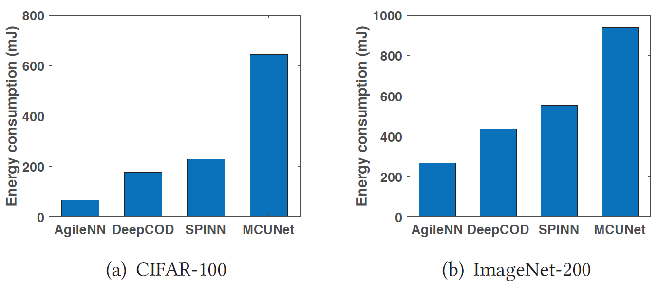
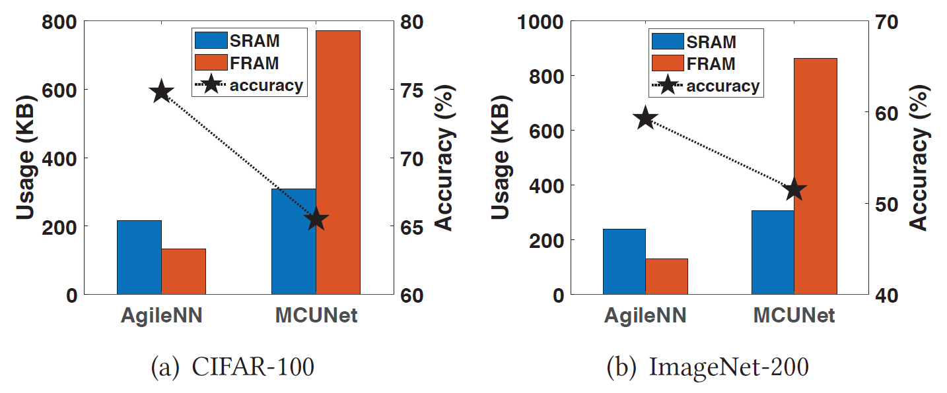
Evaluation: Local Resource Savings
Local Energy Consumption
1.6x-2.5x more efficient than DeepCOD
8x more efficient than MCUNet
Local Memory & Storage
Memory – SRAM, storage – FRAM
Local NN saves 40%-50% memory and > 50% storage
10% higher accuracy
Notes:
We also compare the AgileNN’s local energy consumption to other schemes. Because AgileNN has more lightweight local NN and less data to transmit, it saves more computation and communication costs. The results show that AgileNN’s energy efficiency is 1.6x-2.5x higher than DeepCOD and 8x higher than MCUNet.
Similarly, with 10% higher inference accuracy, AgileNN requires much less local memory and storage compared to MCUNet.

Slide 14
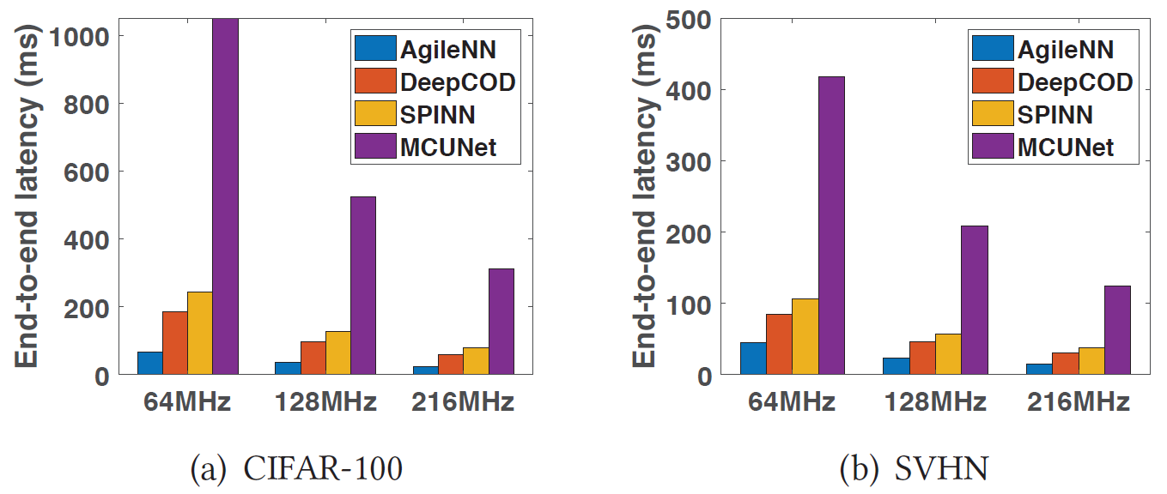
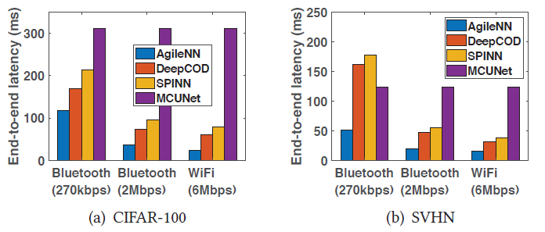
Evaluation: Different System Settings
Impact of Local CPU Frequency
64MHz - 216MHz
Reduces latency by 2.1x to 2.5x
Impact of Network Bandwidth
Bluetooth (270kbps, 2Mbps), WiFi (6Mbps)
Keeps outperforming baselines
Notes:
We also tune the clock scaling factor on the microcontroller board to mimic other types of embedded devices with lower computing power. The results shows that AgileNN can keep end-to-end latency reduction by 2.1x to 2.5x on microcontrollers with different CPU frequencies, and this implies that AgileNN can be adopted on various microcontrollers with different computing powers.
Because of the local constraints on power consumption and form factor, not all the embedded devices are equipped with high-speed WiFi modules. Instead, many of them have to use narrowband low-energy radios such as Bluetooth. Under different bandwidth constraints, AgileNN can constantly outperforms others and restrain the latency within 100ms and 50ms.

Slide 15
Summary
Agile Offloading for Neural Network Inference
AgileNN: shifts the rationale of offloading from fixed to data-centric & agile
Leveraging XAI to achieve such agility
> 6x lower latency and > 8x resource consumption for extremely weak devices
Explainable AI for Systems
First to integrate XAI techniques into NN offloading systems
Migrating XAI computation from device to offline training
Notes:
To summarize, we proposed a new NN offloading technique AgileNN, which leverages XAI to make offloading strategy data-centric and agile. It enables accurate, low latency and low cost NN inference on extremely weak embedded devices.
Our work is the first to integrate XAI techniques to NN offloading systems. And we demonstrate a practical solution to harnessing the power of XAI on weak devices, by migrating the expensive XAI computations from online inference to offline training.

Slide 16
Thank you!
Notes:
This is the end of my presentation. Thank you for listening!

Slide 17
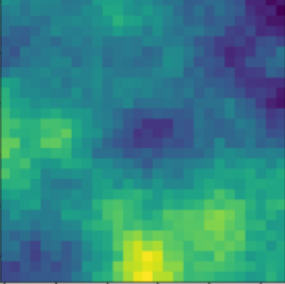
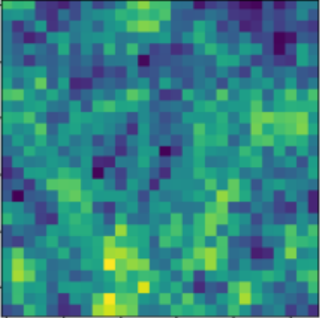
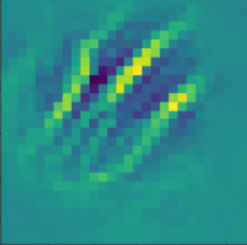
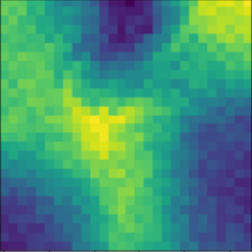
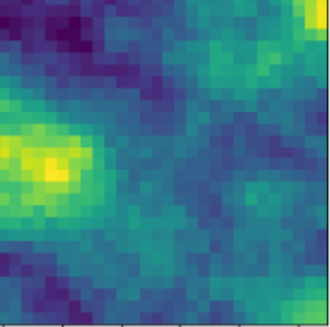
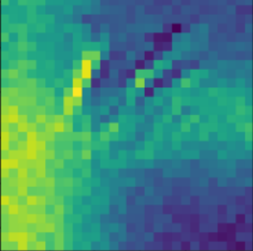
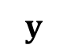
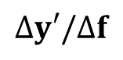
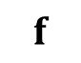
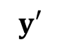
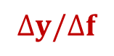
Feature Importance Evaluator
$$Δy/Δf$$
Gradients
Inaccurate
Feature Extractor
Local & Remote NN
Dog: 0.43
$$y$$
Cat: 0.57
$$f$$
Has not been well-trained
Has not been well-trained
initial weights
$$Δy′/Δf$$
Accurate!
Feature Extractor
Dog: 0.99
$$y′$$
Predictor
Cat: 0.01
An off-the-self pretrained model
Notes:
To build a feature importance evaluator, one key issue of existing XAI tools is that the accuracy of feature importance evaluation builds on accurate NN inference in advance. [x] If the NN hasn’t been well-trained, [x] its output will be ambiguous and leads to misleading importance scores. This is because the gradients computed from the NN outputs are highly random.
To address this limitation, we instead use an off-the-shelf well-trained model as a reference network to apply XAI tools. [x][x] Specifically, we initialize the feature extractor with the same weights and feed the features to this well-trained predictor for importance evaluation.

Slide 18
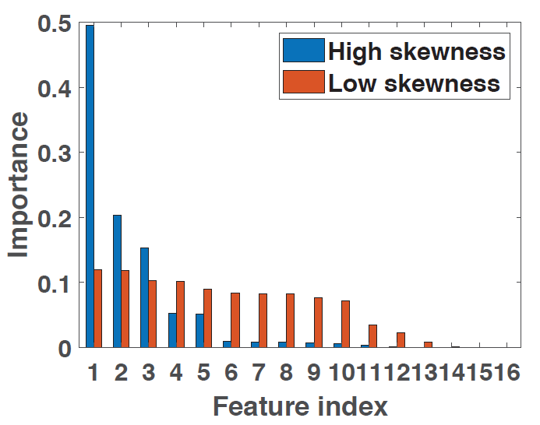




An intuitive example of skewness manipulation
Enforcing skewness
→ focusing on a single flower
Label: dog
Feature extraction
segments from different flowers in the picture
Label: flower
Notes:
Given a dog picture and a flower picture, the blue bars are the importance scores of dog features, and the red bars are the importance scores of flower features.
We can see the dog’s feature importance is highly skewed, because from NN’s perspective, only a small region (the dog face) is saying this picture is a dog picture.
But for the flower picture, many features tend to be equally important and each feature associates a specific flower in the picture, but each of them indicates this picture is a flower picture.

Slide 19
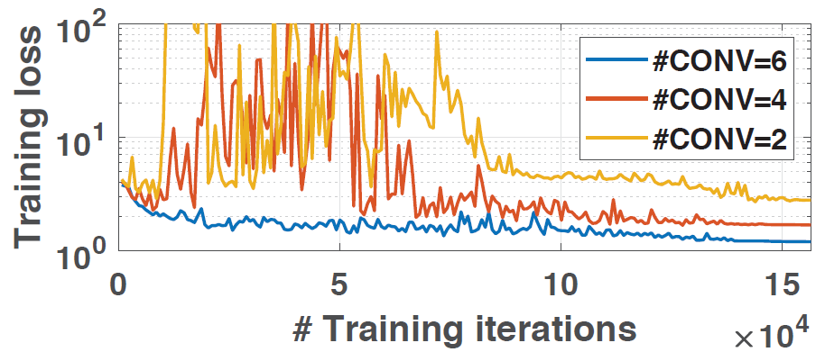


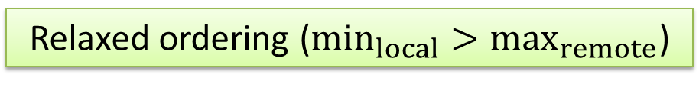
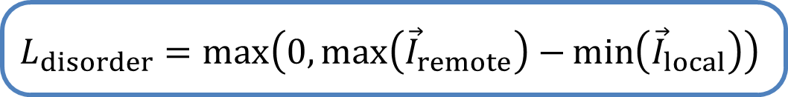
Learning to produce importance-sorted features
Original unsorted features
0.4
Importance
0.3
High learning complexity, require big Feature Extractor
0.2
0.05
0.05
Minimal learning complexity
Feature index
$$L_{disorder}=\max\left(0,\max\left({\vec{I}}_{remote}\right)−\min\left({\vec{I}}_{local}\right)\right)$$
Forcing to be strictly sorted
Relaxed ordering ($\min_{local}>\max_{remote}$)
To local NN
To local NN
0.4
To remote NN
min
0.4
To remote NN
Importance
0.3
Importance
0.3
0.2
0.2
max
0.05
0.05
0.05
0.05
Feature index
Feature index
Notes:
Top important features are not showing in the first-k channels
With accurate importance evaluation, we are able to construct loss functions that teach the feature extractor to produce importance-sorted features.
[x] Given an unsorted feature vector, a straightforward target is to sort them into strictly descending order, of which the loss function can be MSE as the difference between the original importance and the sorted importance. [x] However, this is a very difficult task and requires very high NN complexity. [x] In our experiments, the feature extractor has to stack at least 6 Conv layers to achieve stable training, which is expensive for local devices. [x]
[x] Instead, we think enforcing strict descending order is unnecessary and can be simplified. Specifically, we only enforce the minimum importance of features located in the first k channel to be larger than the maximum importance of features. By enforcing this constraint as a loss function, the features will be partitioned into important and less important portions with minimal learning effort. [x] In our experiments, the relaxed sorting ensures correct feature ordering without impairing the inference accuracy.

Slide 20
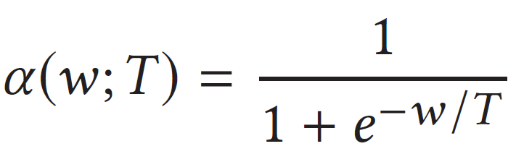
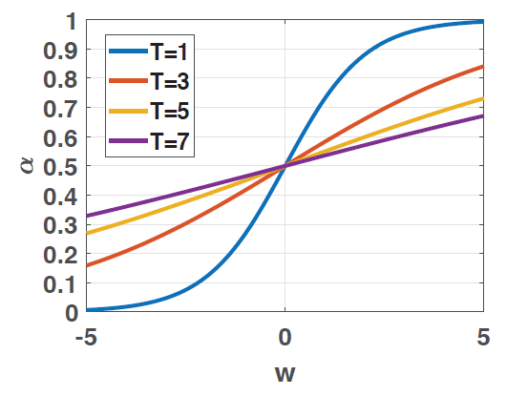




Combining Predictions
Local NN
$$×α$$
Final Prediction
Remote NN
$$×\left(1−α\right)$$
$T$ is too low
$α$ tends to be bias, local NN could be ignored during training
$T$ is too high
equivalent to simple sum, $α$ becomes useless
Notes:
Predictions have different scales.
Use alpha to combine predictions as a weighted sum.

Slide 21


Preprocessing the Feature Extractor
Re-arrange the channel indices of feature extractor’s output
mapping layer
→ local
Feature Extractor
→ remote
feature channel that is more likely to appear top important features
remaining feature channels
Notes:
We add a mapping layer to rearrange the channel indices of feature extractor’s output.
This mapping layer is constructed before training.
More specifically, we traverse the training dataset, feed every training data sample to the feature extractor, and find the channel that …

Slide 22

Evaluation: Training Convergence and Cost
AgileNN exhibits a very similar convergence rate vs. regular training
Wall-clock time increases by 3x-4x due to XAI loss computation
Notes:
As a prerequisite, we first evaluate the quality and cost of AgileNN’s training. As shown in Figure, during the training procedure, AgileNN exhibits a very similar rate of training convergence in terms of test accuracy and loss, compared to regular training of MobileNetV2 on CIFAR-100 and SVHN datasets.
On the other hand, we observe 3x-4x wall-clock time increase for each training epoch in AgileNN. This is because the training should pay extra computation to evaluate feature importance and obtain the corresponding training feedback. But this is pure offline efforts, and we can also reduce training time by using more lightweight XAI tools.

Slide 23


Evaluation: Enforcing Skewness
Enforcing higher skewness helps reduce communication latency
Require higher local prediction power
Higher compressibility
Notes:
In AgileNN’s training, we encourage higher skewness of feature importance to improve compressibility and reduce communication latency.
In our evaluation, for example, on cifar100 dataset, if we enforce 20% of features to occupy from 70% to 90% of total importance. We can reduce the transmission time by half but this also reduces the inference accuracy because the local predictor may not be powerful enough to process more information.
This tradeoff also appears on other datasets.

